Slide 1

GIFT #201

Slide 2
Contents
Problem statement
Team overview
Society
Impacted community
Tech discussion
Proposed Solution
Innovation
Technologies
Implementation
Cost Savings
Challenges

Slide 3
Problem statement
Disabled persons are not able to browse the website (http://www.giftabled.org/)
All Donations are offline
Offline Donor conversion ratio is less

Slide 4
Team overview
Nitin Gupta
Mayur Mahant
Krupesh Patel
Dharmesh Guna
Dipen Jogi
Stephen
Saravanan Thandapani
Balaji

Slide 5
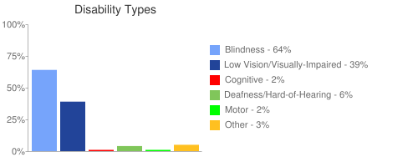
Impacted community - Society
Visual
Blindness, low vision, color-blindness
Hearing
Deafness & heard of hearing
Motor
Inability to use a mouse, slow response time, limited fine monitor control

Slide 6
Tech discussion - Technologies
Tech stack
PHP
MySql
Javascript
HTML
Frameworks
Wordpress
Themes
Plugin
JQuery
Google
Text render engine
Accessibility testing
AATT (PayPal open source)
Wave.webaim.org
Open Source Technologies

Slide 7
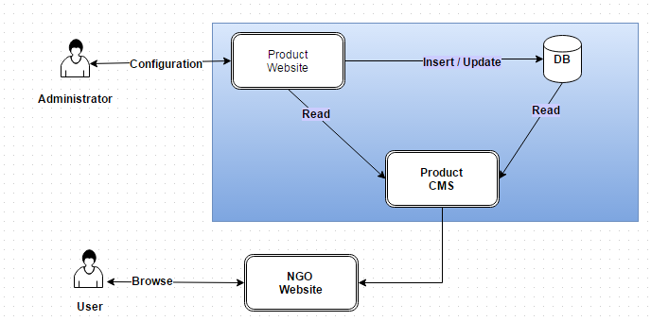
Innovation & Extendibility
JAWS license cost is 1000$ per windows system
Solution provided will work for any website with small configuration changes

Slide 8
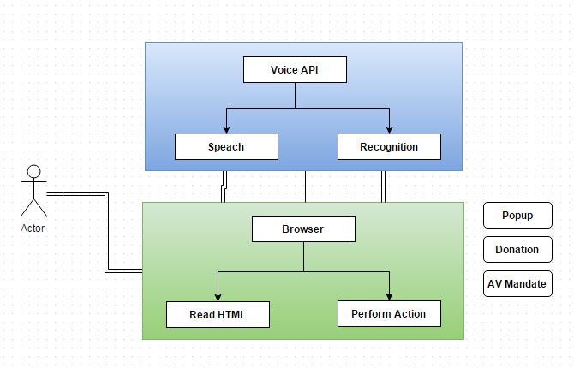
Implementation

Slide 9
Demo
http://www.giftabled.org

Slide 10
Thank you..!!
Q & A

